Slide 1
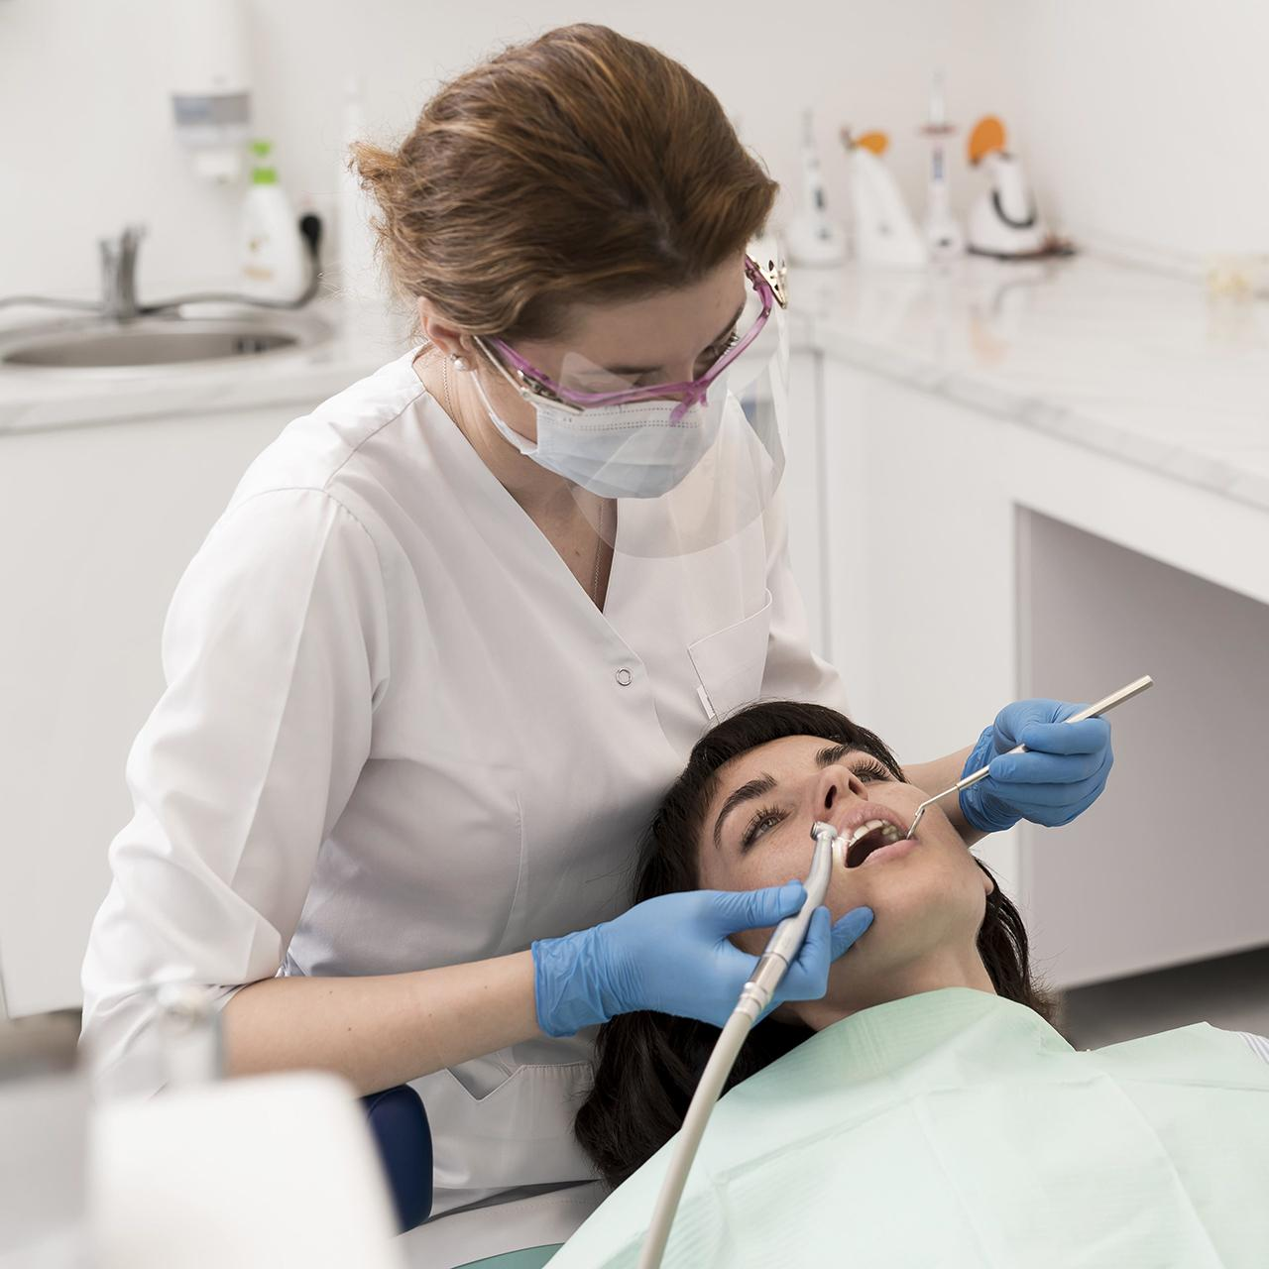
Analysis of the work of the dental clinic Denta +

Slide 2
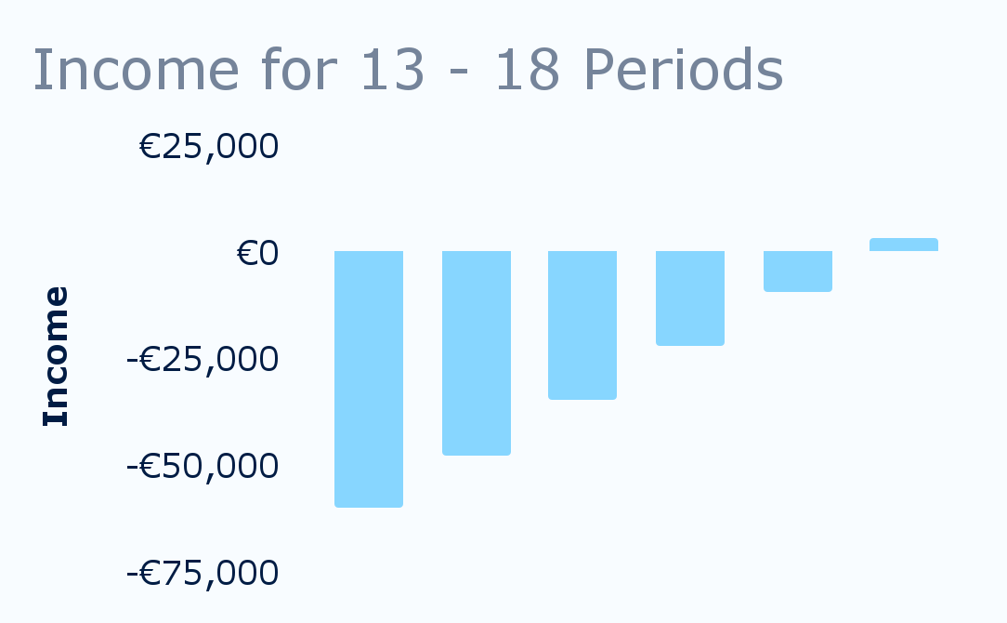
Forecast for the next two quarters
Period | 12 | 13 | 14 | 15 | 16 | 17 | 18
Visits | 452 | 476 | 476 | 480 | 480 | 480 | 480
ACV | €235 | €235 | €235 | €235 | €235 | €235 | €235
Expenses | €102,927 | €101,028 | €99,028 | €99,338 | €99,524 | €99,524 | €99,524
Marketing | €0 | €2,000 | 0 | 0 | 0 | 0 | 0
Operational | €28,000 | €28,000 | €28,000 | €28,000 | €28,000 | €28,000 | €28,000
Personnel | €37,900 | €34,300 | €34,300 | €34,300 | €34,300 | €34,300 | €34,300
Service | €37,027 | €36,728 | €36,728 | €37,038 | €37,224 | €37,224 | €37,224
Income | €106,309 | €111,296 | €111,296 | €112,236 | €112,236 | €112,236 | €112,236
Profit | €3,382 | €10,268 | €12,268 | €12,898 | €12,712 | €12,712 | €12,712
Total | -€70,558 | -€60,290 | -€48,021 | -€35,123 | -€22,411 | -€9,699 | €3,013
For more info: SLIDESGO | BLOG | FAQs

Slide 3
Analysis by the following indicators:
01
02
03
04
Customer return
Customer reviews
You can describe the topic of the section here
You can describe the topic of the section here
Feedback on doctors
Who is our client
You can describe the topic of the section here
You can describe the topic of the section here

Slide 4
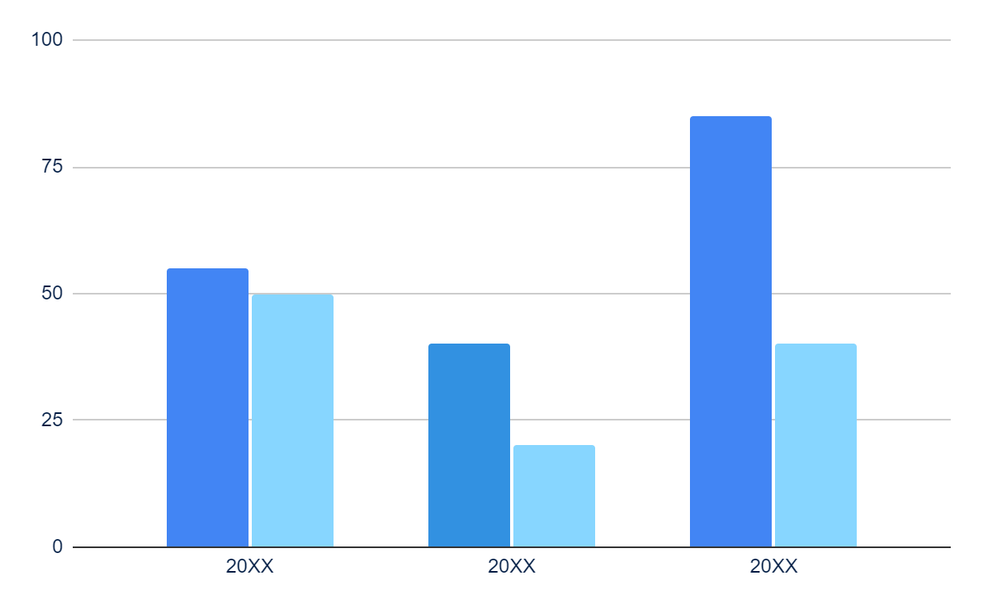
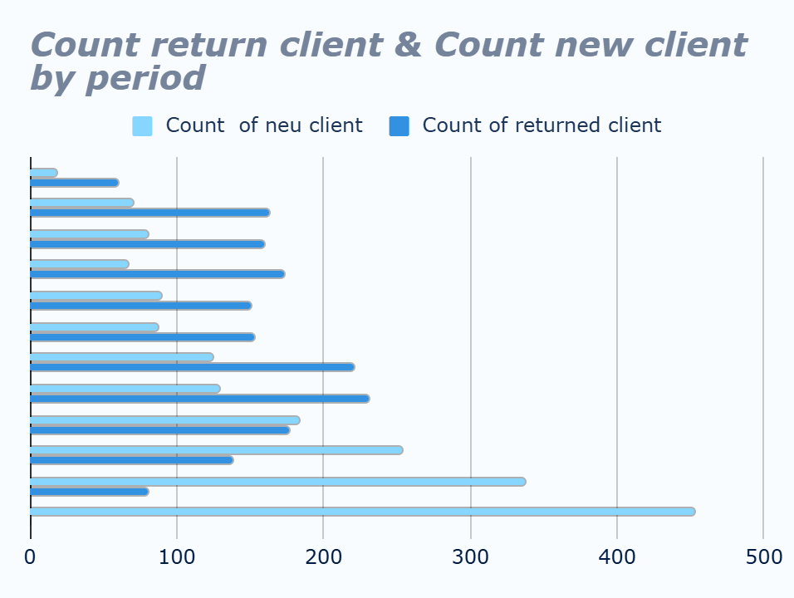
Analyzing customer returns
Output:
The number of new customers is growing
The number of repeat customer visits is declining
Solution:
Investigate the reasons for the decline in customer returns and implement a customer retention strategy

Slide 5
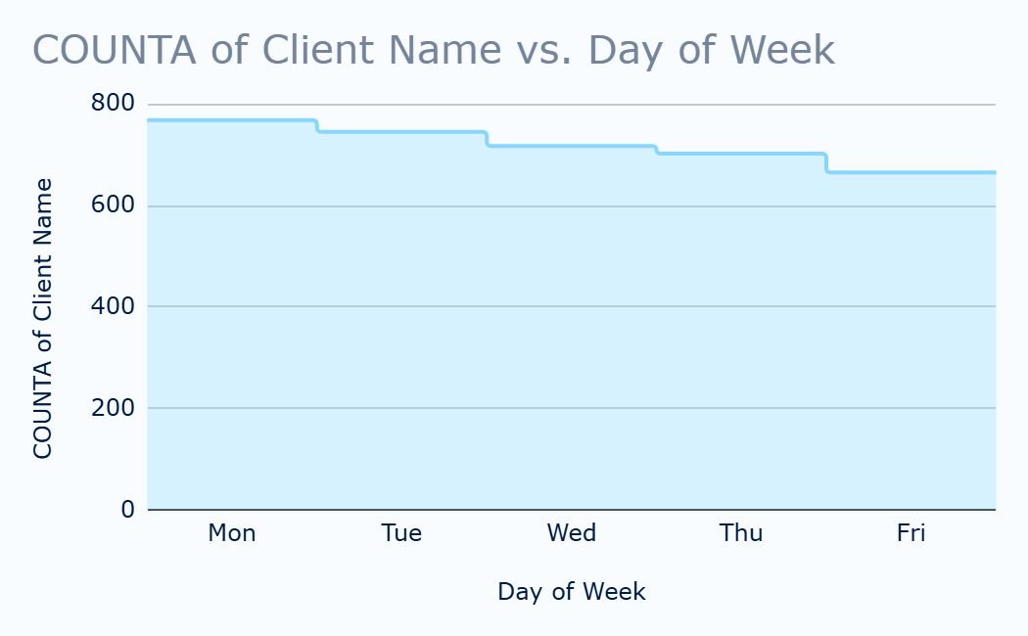
Analyzing the clinic's working days
Output:
The schedule shows that Wednesday, Thursday, and Friday have insufficient bookings
Solution:
We offer a 10% discount for the first 2 hours on Wednesday, Thursday, and Friday. Filling in the appointments

Slide 6
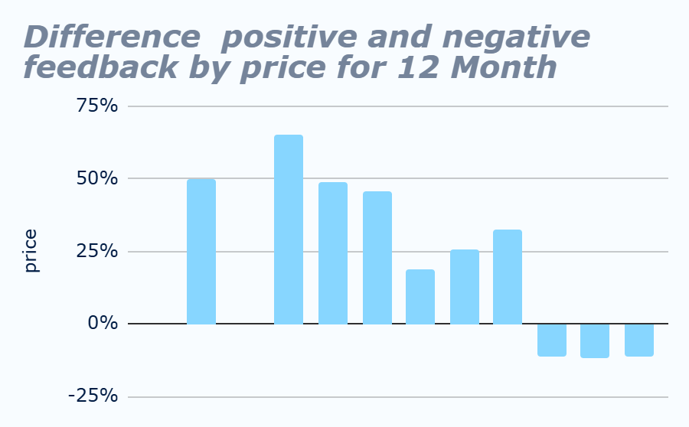
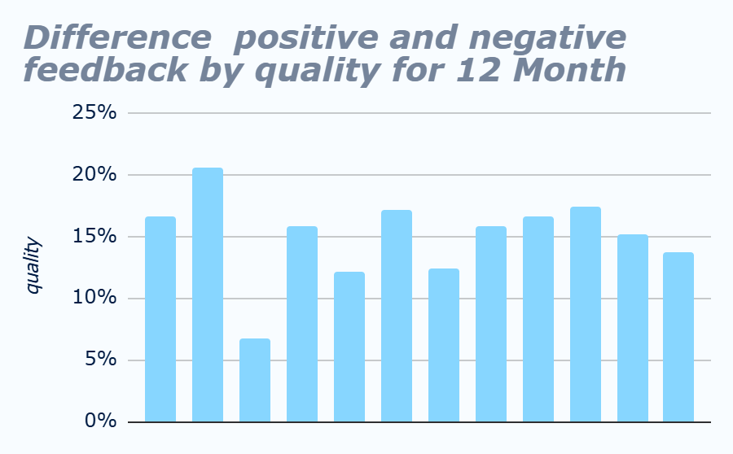
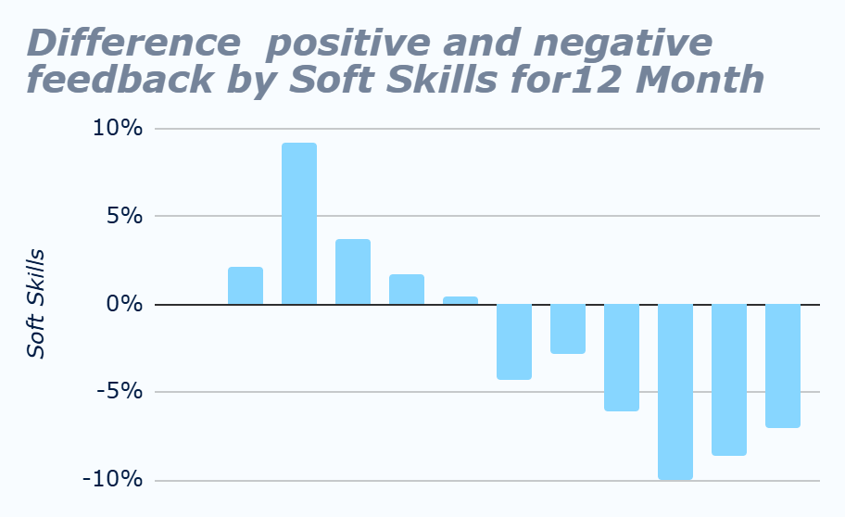
Analyzing customer reviews over the past 12 months
50%
Conclusion
Conclusion:
Solution:
We see that the quality of service remains at the same, but not high level
The number of dissatisfied customers is growing due to price and soft skills
Diving deeper into data analysis to understand the reasons for negative feedback

Slide 7
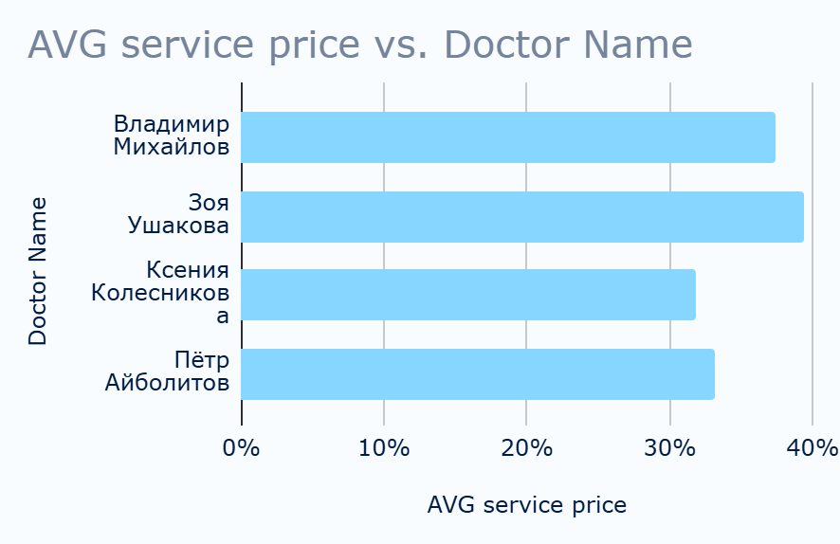
Analyzing the working days of the clinic
Output:
The material costs of Petr Aibolitov and Kseniya Kolesnikova are much lower
Solution:
We spend 33% of the price on materials

Slide 8
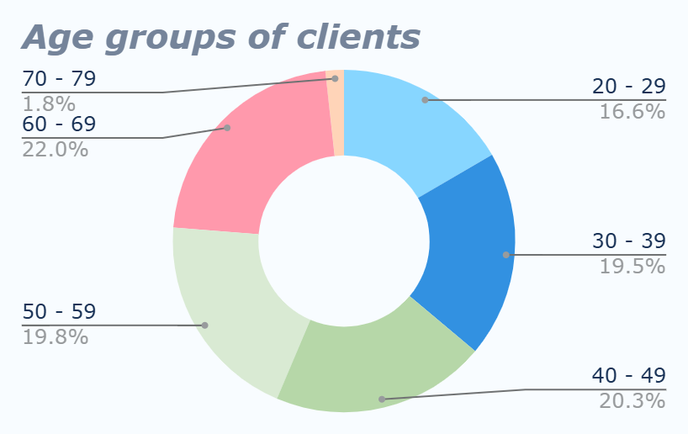
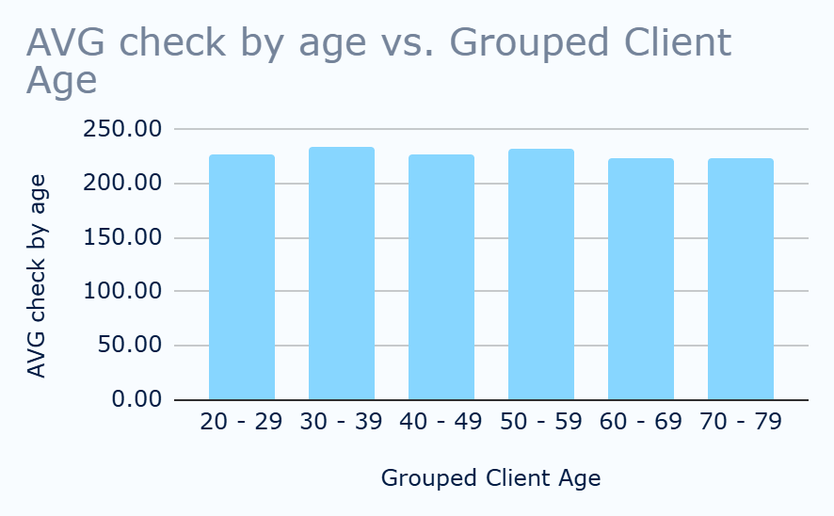
Who is our client
Output:
Output:
No data on clients under 20 years old
We see that the average checks of clients are the same, which means that each age group is equally interesting to us

Slide 9
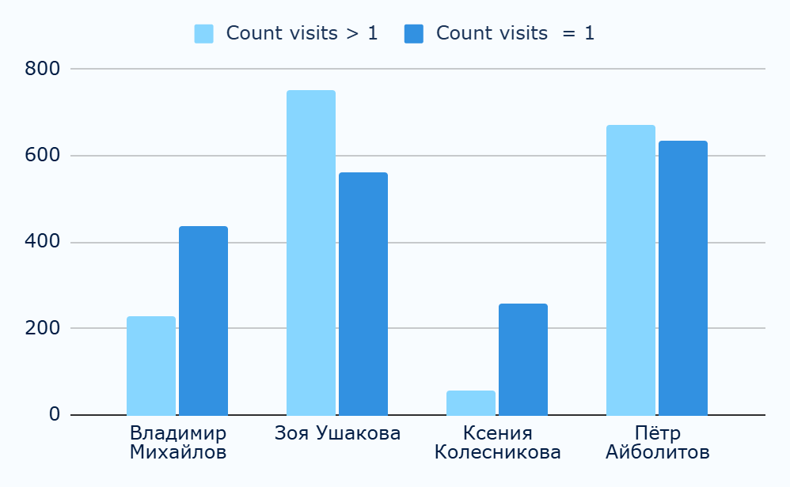
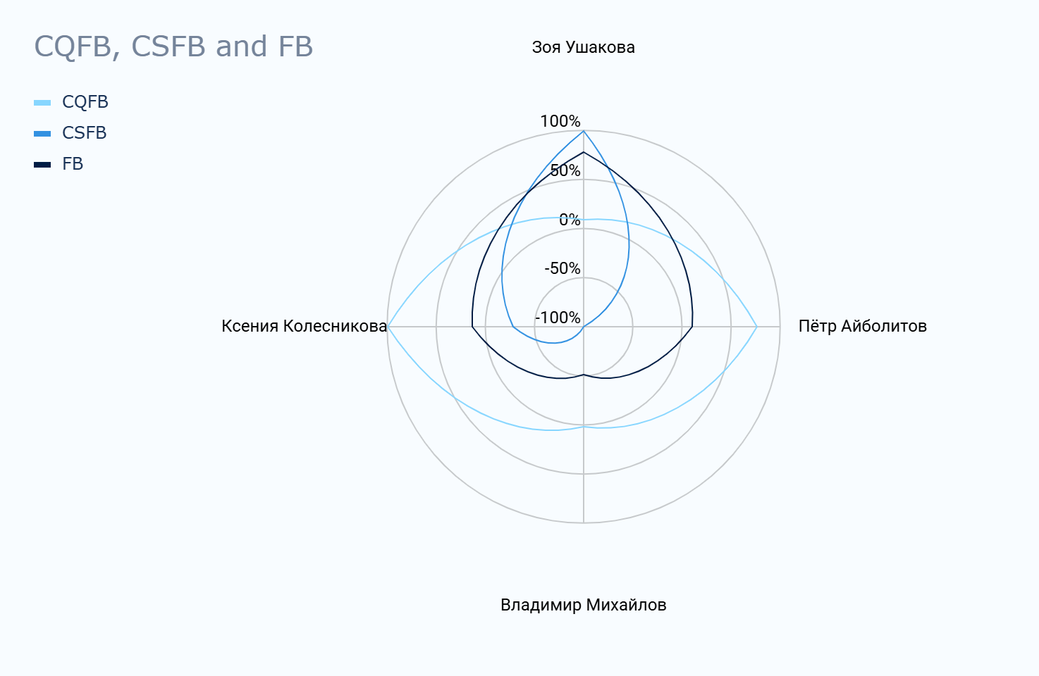
Studying Feedback on Doctors
Conclusion:
Conclusion
Conclusion:
Doctor Vladimir Mikhailov lacks sufficient qualifications and Soft Skills
Soft Skills are very low for all doctors except for Zoya Ushakova
Zoya Ushakova works well, but the quality of work is quite low

Slide 10
Thanks!
Do you have any questions?
iuliia4082@gmail.com

